Slide 1



BADM Buddies
Avaneesh, Nithila, Sheetal, Shreya

Slide 2
Problem Statement
Which features contribute most to preventable hospitalizations?

Slide 3
Approach
1
Data Preprocessing
2
Exploratory Data Analysis
3
Data Modeling
4
Solution

Slide 4








Overview of Tools

Slide 5
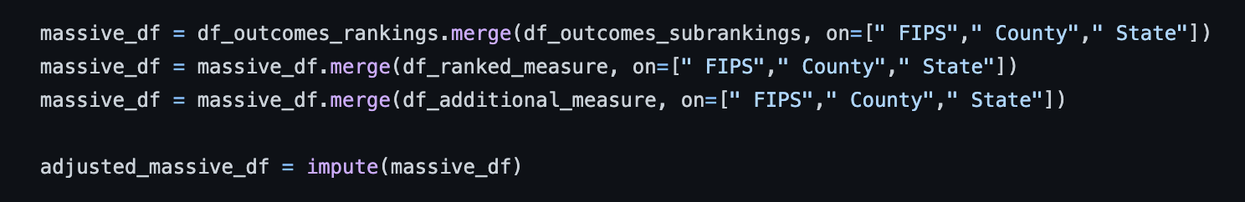
Data Preprocessing
Joined the Excel sheets “Ranked Measure Data” and “Additional Measure Data”
Imputed missing values with the median
Removed outliers using the Stats module from SciPy library

Slide 6
Exploratory Data Analysis
Utilized Spearman’s correlation values to evaluate strength of relationships between preventable hospitalization rates and other variables
Split dataframe into medical and social features to aid categorization of relationships

Slide 7
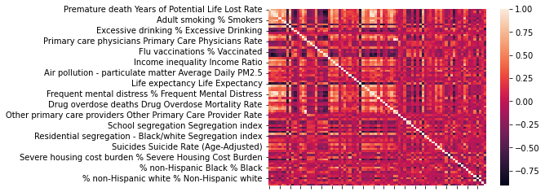

Slide 8
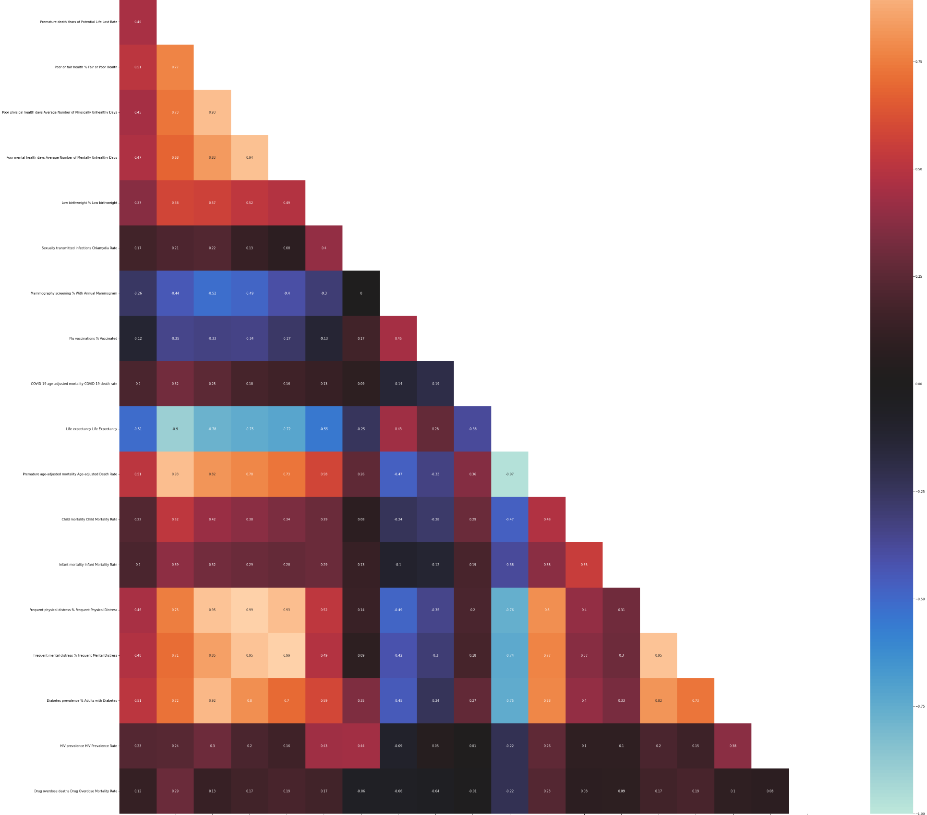

Slide 9
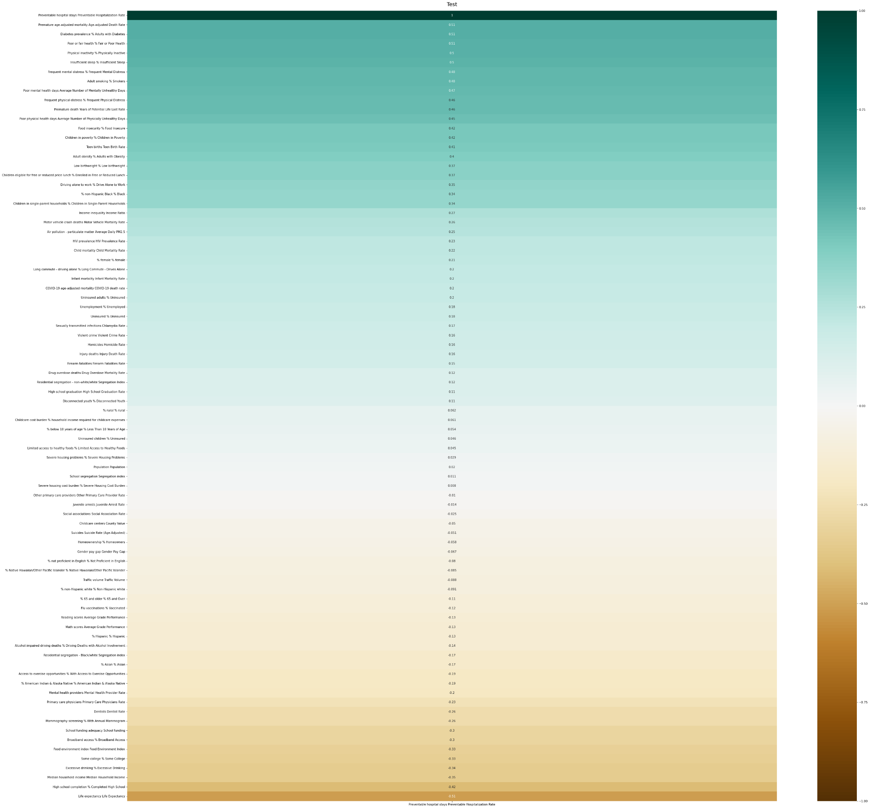
Premature age adjusted death rate
0.51
% adults with diabetes
0.51
0.51
% fair or poor health
0.50
% physically inactive

Slide 10
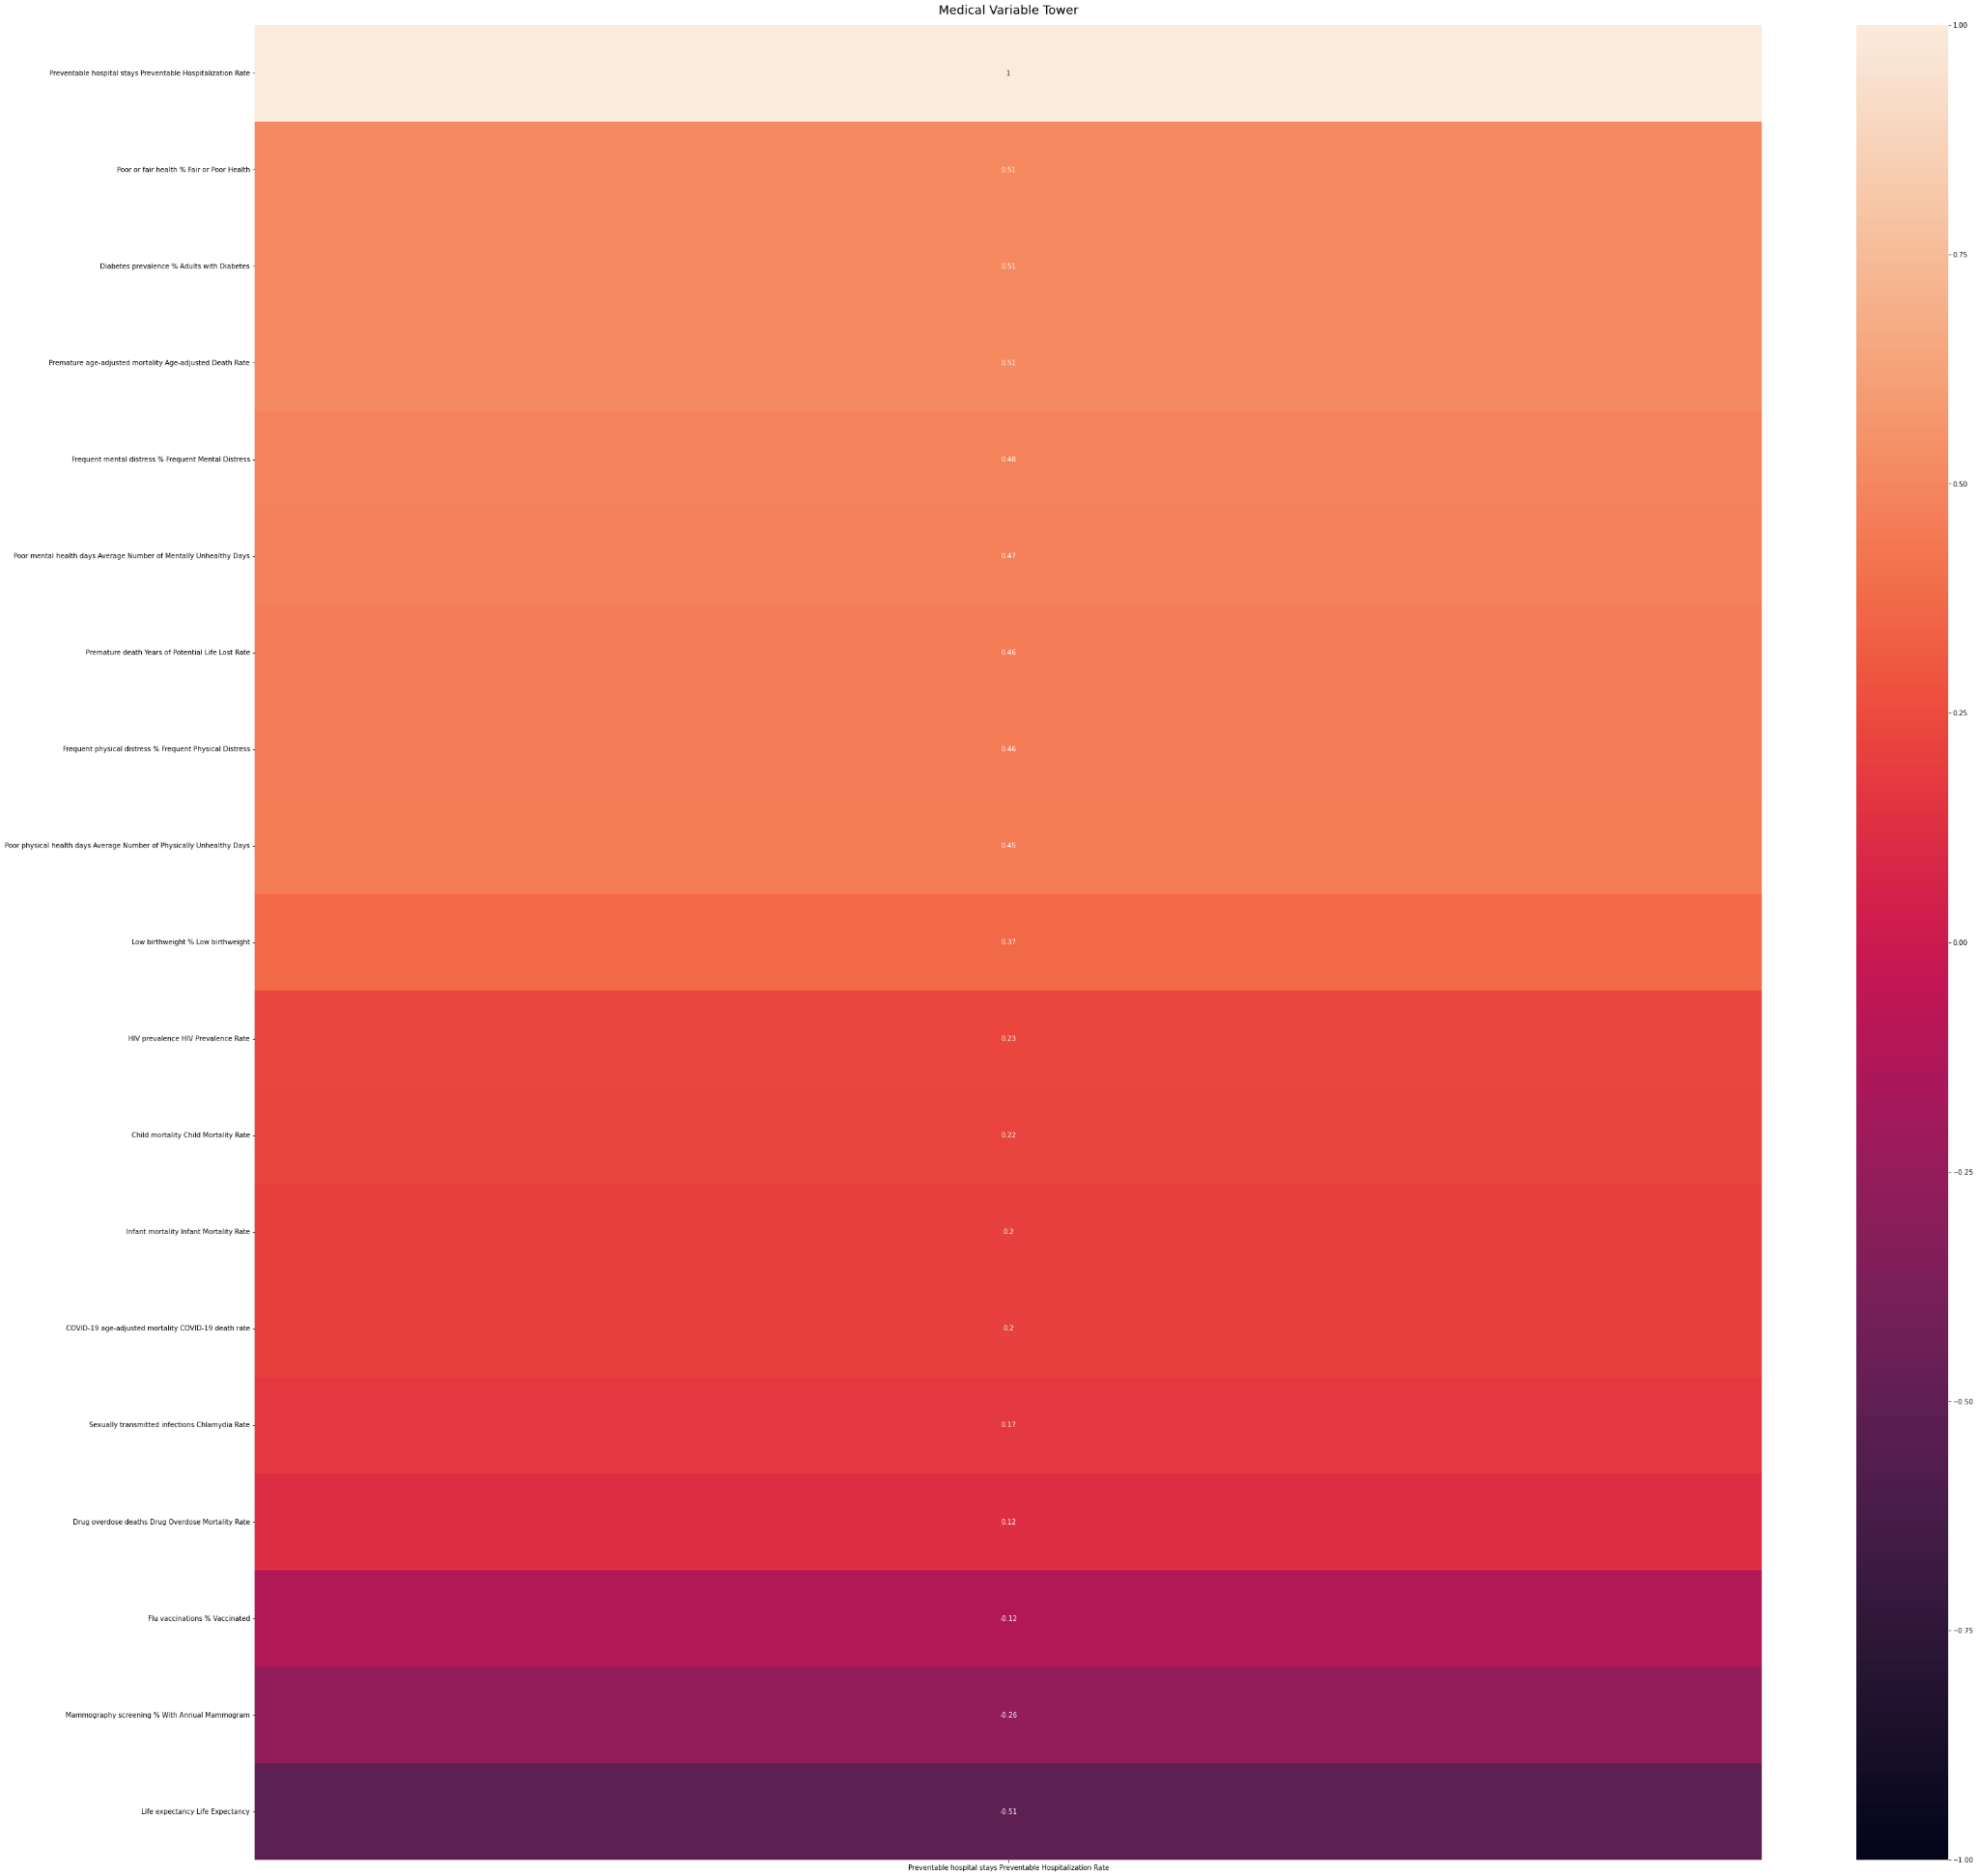
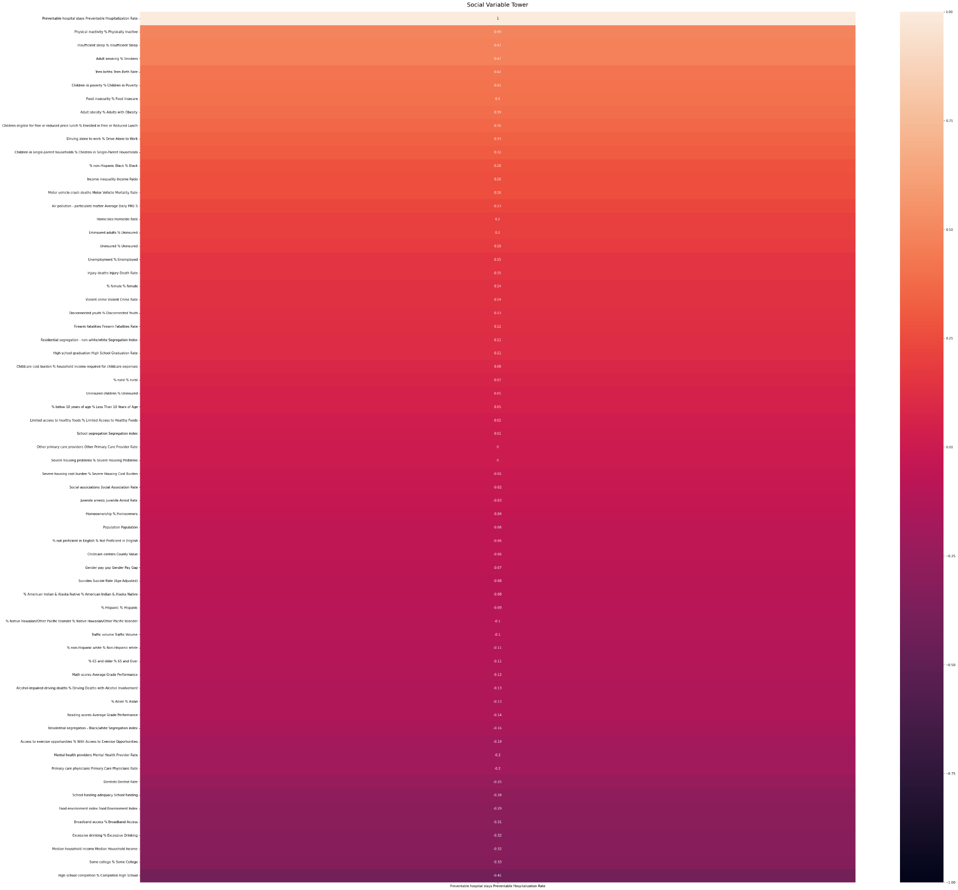

Slide 11
Physical inactivity % physically inactive
0.51
Poor or fair health % fair or poor health
0.49
Insufficient sleep
Diabetes prevalence % adults with diabetes
0.47
0.51
0.47
% Frequent mental distress
% smokers
0.51
Notes:
scikit learn dimensionality reduction

Slide 12
Data Modeling
Decided to use a linear regression model as we wanted to use the given factors to predict the value of the preventable hospitalization rate
Split the data frame into two using social and medical factors
Used sklearn MinMaxScaler() to normalize variables
Performed two linear regressions on both medical and social data
Performance metrics:
Mean Squared Error Medical Model: 0.0185956
Mean Squared Error Social Model: 0.0169153

Slide 13
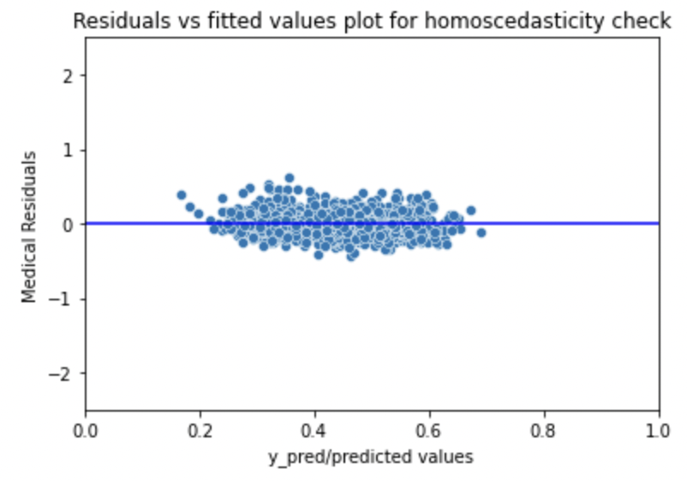
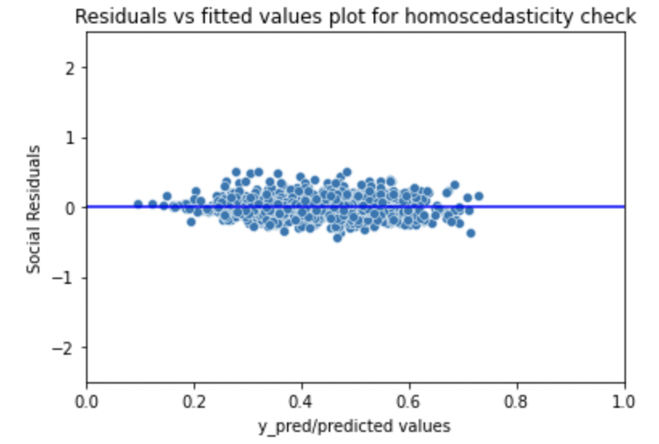
Assumptions for Linear Regression
Linearity between independent and dependent variables
Mean of Residuals should be close to 0
Homoscedasticity
Normality of error terms
No autocorrelation of residuals
No perfect multicollinearity
Notes:
validate linear regression (5 things to validate)
libraries have tools to show validity

Slide 14
Results & Solution
From the given data we can start to see a few trends:
Social Problems
Physically Inactive
Insufficient Sleep
Smoking
Medical Problems
Poor Health %
Diabetes %
Mental Distress %
Some Solutions to reduce preventable hospital stays:
62.2% of the United States is currently employed
Employer benefits by providing break time
Student health and wellbeing regulation
Notes:
explain causation behind variables chosen
- e.g. how would being physically inactive lead to hospitalizations?
add a next steps slide

Slide 15
Next Steps
Events encouraging mindfulness and self care
Initiatives that promote healthy lifestyles
Build on current events/initiatives within Optum/UHC
UnitedHealthcare Motion
Notes:
in terms of actionable steps to take, we believe companies should host more events that encourage mindfulness and self care which relates directly to the mental distress aspect that we found to be relevant
additionally, we think companies should implement initiatives that promote healthy lifestyles through daily exercise and healthy eating that target the variable of physical inactivity
specifcially, we were looking into initiatives that optum and uhc are currently doing and we really liked the united healthcare motion initiative which encourages its employees to prioritize daily exercise and we believe this should be something all companies implement, whether they are healthcare based or not

Slide 16

Thank you!

